Slide 1
Data Science with R Insurance Project
By Umaima Surti
13-Sep-17

Slide 2
Loading the data
setwd("C:/Data Science/R/Code")
Insdata <- read.csv("SwedishMotorInsurance.csv")
View(Insdata)
dim(Insdata)

Slide 3
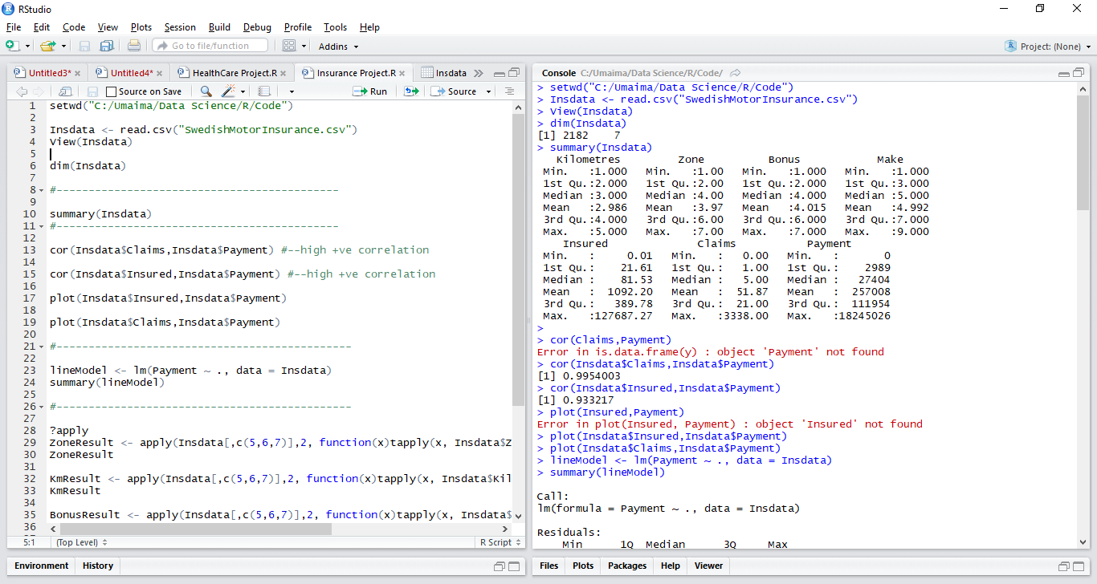
Ans 1) In order to get basic insights onto the dataset and perform descriptive analysis, we do the following: summary(Insdata)
Interpretation of the results:
The result gives 5 point summary of each column of the data. This gives the spread of data.
There are some 0 values in Claims and Payment though the car has been Insured. This means no Claim or Payment has been made for that datapoint(s)

Slide 4
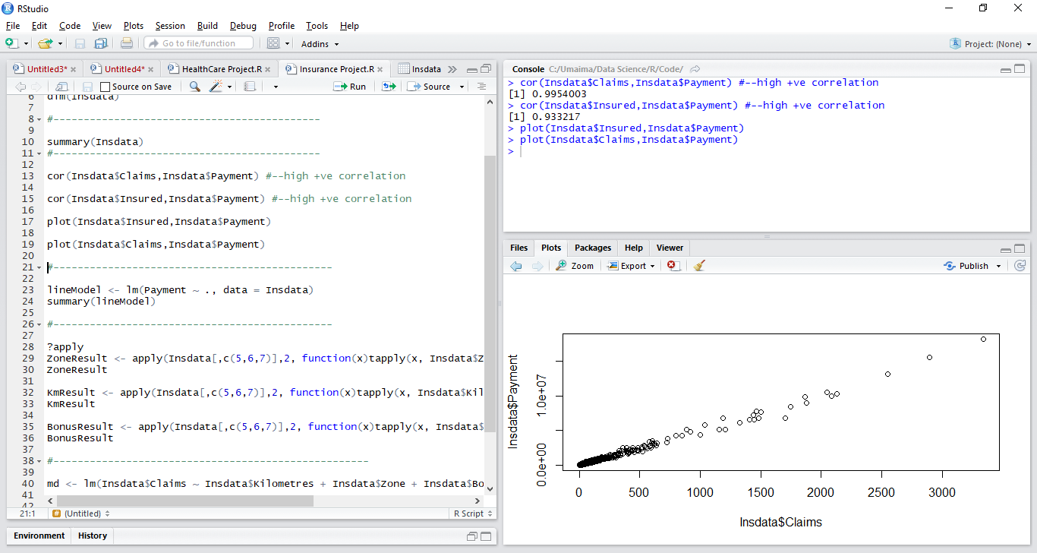
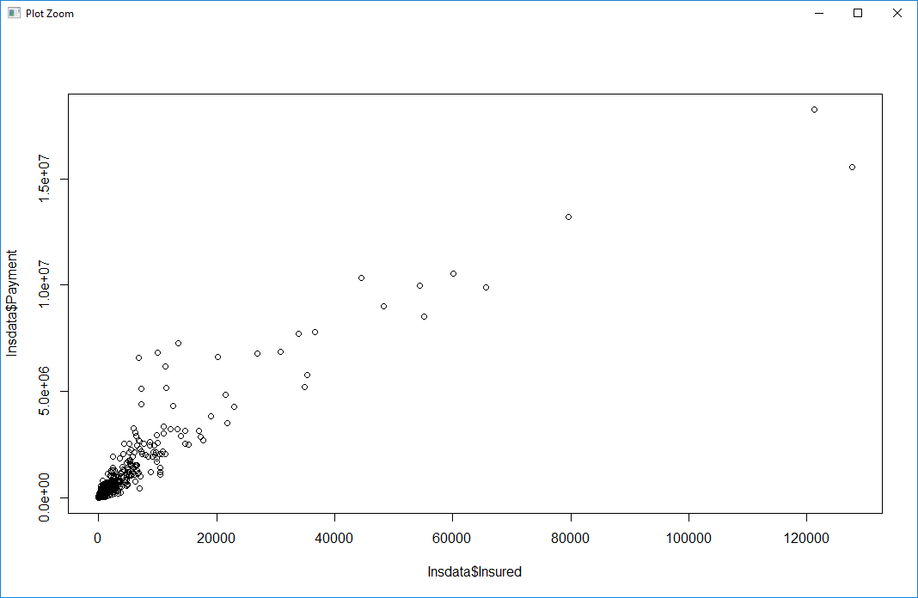
Ans 2) We have to use correlation to find a relationship cor(Insdata$Claims,Insdata$Payment) cor(Insdata$Insured,Insdata$Payment) plot(Insdata$Insured,Insdata$Payment) plot(Insdata$Claims,Insdata$Payment)
Interpretation of the output:
From the correlation output, we can see that there is Strong Positive Correlation between Claims and Payment (precisely 99.5%) and also between Insured and Payment (93.3%)
From the plot we can see that as the Claims increase, the Payment increases
Similarly as the Insured increases, Payment increases

Slide 5
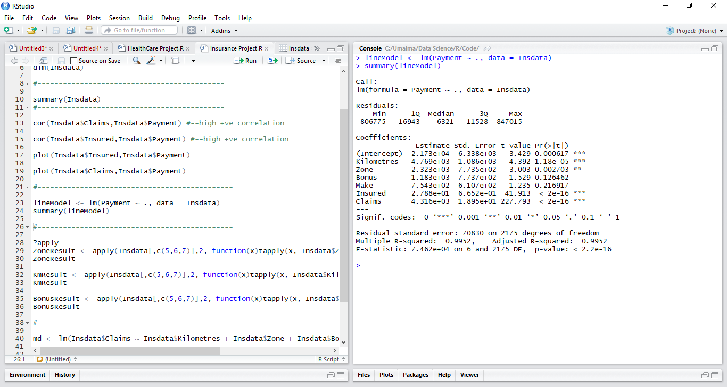
Ans 3) To perform Linear Regression on Payment as dependent variable and others as independent variables lineModel <- lm(Payment ~ ., data = Insdata) summary(lineModel)
Interpretation of the output:
From the output, we see that Kilometers, Zone, Insured, Claims are significant variables whose values will affect the Payment variable
Make and Bonus variables have high P-value, hence they are not signification for the given data
Also using the intercept and Estimate values for all variables a linear equation can be formed which can be used to predict the Payment values

Slide 6
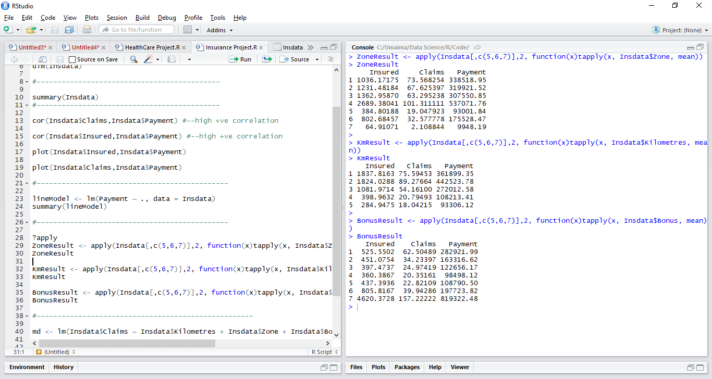
Ans 4) To find when the Insured, Claims & Payment increases, we need to find the mean of the categorical values of Kilometre, Location, Bonus ZoneResult <- apply(Insdata[,c(5,6,7)],2, function(x)tapply(x, Insdata$Zone, mean)) ZoneResult KmResult <- apply(Insdata[,c(5,6,7)],2, function(x)tapply(x, Insdata$Kilometres, mean)) KmResult BonusResult <- apply(Insdata[,c(5,6,7)],2, function(x)tapply(x, Insdata$Bonus, mean)) BonusResult
Interpretation of the results:
Zone 7 has the lowest Insured, Claims and Payment and Zone 4 has the highest
Most of the Payments and Claims comes from Zones 1 to 4
Kilometre group 5 has the lowest Claims and Payment and group 2 has the highest
Bonus group 7 has drastically high in terms of Insured, Claims and Payment compared to the other 6 groups

Slide 7
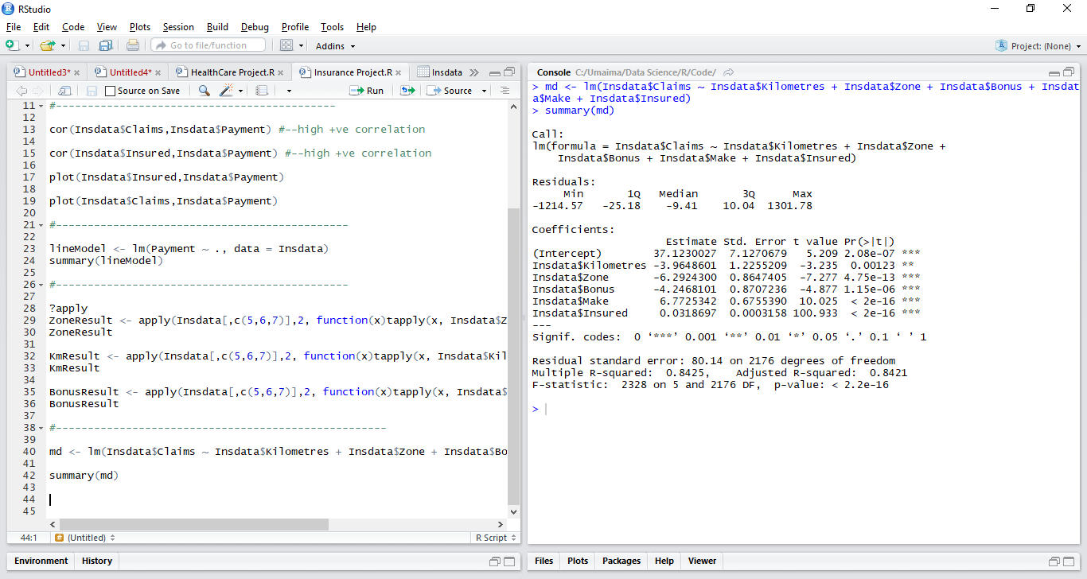
Ans 5) Claims is the Dependent variable and Kilometre, Zone, Bonus, Make and Insured are independent variables md <- lm(Insdata$Claims ~ Insdata$Kilometres + Insdata$Zone + Insdata$Bonus + Insdata$Make + Insdata$Insured) summary(md)
Interpretation of the results:
From the output, looking at the p-values, we can infer that all of our independent variables are highly significant and have a strong influence on the Claims variable

